Slide 1

CSE- 208
Algorithms Lab
Lab: 06
Fahad Ahmed
Lecturer, Dept. of CSE
E-mail: fahadahmed@uap-bd.edu

Slide 2


Merge Sort

Slide 3
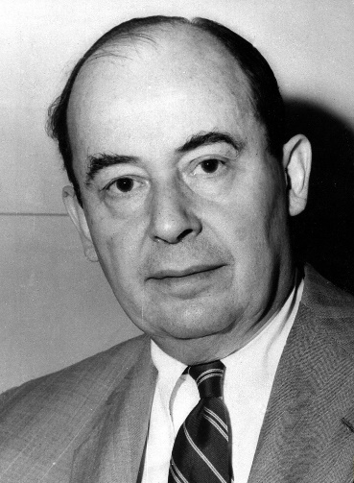
Merge Sort
Merge Sort was developed by John von Neumann in 1945.
Austria-Hungary A mathematician who made major contributions to set theory, functional analysis, quantum mechanics, continuous geometry, economics and game theory, numerical analysis, hydrodynamics.

Slide 4
Merge sort
merge sort: Repeatedly divides data in half, sorts each half, and combines the sorted halves into a sorted whole.
The algorithm:
Divide the list into two roughly equal halves.
Sort the left half.
Sort the right half.
Merge the two sorted halves into one sorted list.
Often implemented recursively.

Slide 5
Merge sort example
index | 0 | 1 | 2 | 3 | 4 | 5 | 6 | 7
value | 22 | 18 | 12 | -4 | 58 | 7 | 31 | 42
split
22 | 18 | 12 | -4
58 | 7 | 31 | 42
split
split
22 | 18
12 | -4
58 | 7
31 | 42
split
split
split
split
22
18
12
-4
58
7
31
42
merge
merge
merge
merge
18 | 22
-4 | 12
7 | 58
31 | 42
merge
merge
-4 | 12 | 18 | 22
7 | 31 | 42 | 58
merge
-4 | 7 | 12 | 18 | 22 | 31 | 42 | 58

Slide 6
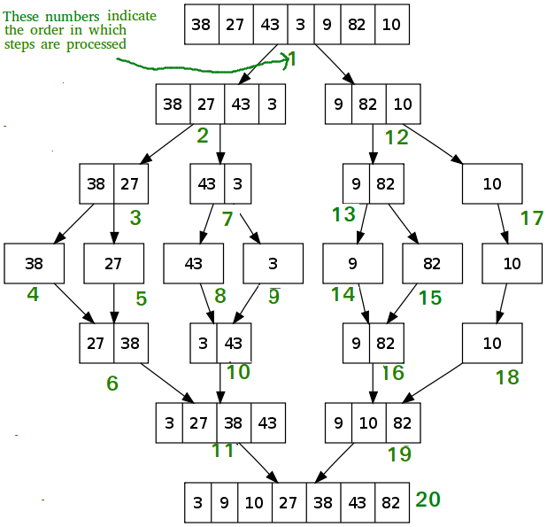
Merge Sort

Slide 7
Merge Sort
MergeSort (A, l, h)
If l <h
1. Find the middle point to divide the array into two halves:
middle m = (l+h) /2
2. Call mergeSort for first half:
Call mergeSort(A, l, m)
3. Call mergeSort for second half:
Call mergeSort(A, m+1, h)
4. Merge the two halves sorted in step 2 and 3:
Call merge(A, l, h, m)

Slide 8
Activity selection problem

Slide 9
An Activity Selection Problem (Conference Scheduling Problem)
Input: A set of activities S = {a₁,…, a_{n}}
Each activity has start time and a finish time
a_{i}=(s_{i}, f_{i})
Two activities are compatible if and only if their interval does not overlap
Output: a maximum-size subset of mutually compatible activities

Slide 10
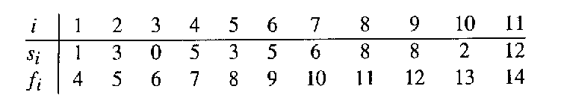
The Activity Selection Problem
Here are a set of start and finish times
Not observed yet
Added in optimal solution
Removed from the list

Slide 11
Early Finish Greedy
Select the activity with the earliest finish
Eliminate the activities that could not be scheduled
Repeat!

Slide 12
i-1
i-2
i-3
i-4
i-5
i-6
i-7
i-8
i-9
i-10
i-11
0 1 2 3 4 5 6 7 8 9 10 11 12 13 14 15

Slide 13
i-1
i-2
i-3
i-4
i-5
i-6
i-7
i-8
i-9
i-10
i-11
0 1 2 3 4 5 6 7 8 9 10 11 12 13 14 15

Slide 14
i-1
i-2
i-3
i-4
i-5
i-6
i-7
i-8
i-9
i-10
i-11
0 1 2 3 4 5 6 7 8 9 10 11 12 13 14 15

Slide 15
i-1
i-2
i-3
i-4
i-5
i-6
i-7
i-8
i-9
i-10
i-11
0 1 2 3 4 5 6 7 8 9 10 11 12 13 14 15

Slide 16
i-1
i-2
i-3
i-4
i-5
i-6
i-7
i-8
i-9
i-10
i-11
0 1 2 3 4 5 6 7 8 9 10 11 12 13 14 15

Slide 17
i-1
i-2
i-3
i-4
i-5
i-6
i-7
i-8
i-9
i-10
i-11
0 1 2 3 4 5 6 7 8 9 10 11 12 13 14 15

Slide 18
i-1
i-2
i-3
i-4
i-5
i-6
i-7
i-8
i-9
i-10
i-11
0 1 2 3 4 5 6 7 8 9 10 11 12 13 14 15

Slide 19
Select the activity with the earliest finish
i-1
i-2
i-3
i-4
i-5
i-6
i-7
i-8
i-9
i-10
i-11
0 1 2 3 4 5 6 7 8 9 10 11 12 13 14 15

Slide 20
The Activity Selection Problem
Here are a set of start and finish times
What is the maximum number of activities that can be completed?
{a₃, a₉, a₁₁} can be completed
But so can {a₁, a₄, a_{8’} a₁₁} which is a larger set
But it is not unique, consider {a₂, a₄, a_{9’} a₁₁}

Slide 21
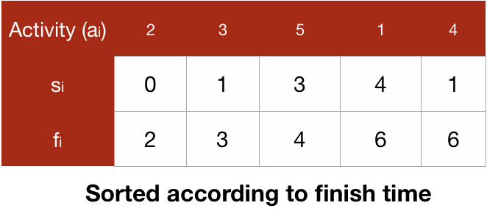
Activity Selection Problem- Another Example

Slide 22
To take the element with the least finish time, we will iterate over the list of the activities and will select the first activity and then we will select the activity which is starting next after the currently selected activity finishes.

Slide 23
Activity Selection Problem- Greedy Algorithm
Make greedy choices: select a job to start with. Which one?
Select the job that finishes first
Assumption: Jobs are sorted according to finishing time.
Create sub problems: leaving this job, leaves you with a smaller number of jobs to be selected.
Solve Sub problems: Continue first two steps until the all the jobs are finished. (recursion!)

Slide 24
Activity Selection Problem –
// n --> Total number of activities
// s[] --> An array that contains start time of all activities
// f[] --> An array that contains finish time of all activities
void Activities(int s[], int f[], int n)
{
int i, j;
printf ("Following activities are selected n");
// The first activity always gets selected
i = 0;
printf("%d ", i);
// Consider rest of the activities
for (j = 1; j < n; j++)
{
// If this activity has start time greater than or equal to the
//finish time of previously selected activity, then select it
if (s[j] >= f[i])
{
printf ("%d ", j);
i = j; // update the last scheduled activity
}
}
}
Running time complexity = O(n)

Slide 25

Thanks to All

